Slide 1
Quality Checks for Understanding (CfU)

Slide 2

Prior knowledge starter quiz
Fill in the blanks in our three step process to creating coherent prior knowledge starter quizzes.
1
2
3
Identify three to four pieces of knowledge that need activating.
Identify where this knowledge was first taught.
Within the same unit, or prior units?
Design your questions.
Sequence your questions.
three
or four
same
Sequence your questions
unit

Slide 3

Prior knowledge starter quiz
What is the minimum number of CfUs that you should have in a learning cycle?
one
two
three

Slide 4
I can design high quality and varied checks for understanding.

Slide 5
Quality Checks for Understanding (CfU)
Purpose
Approaches

Slide 6
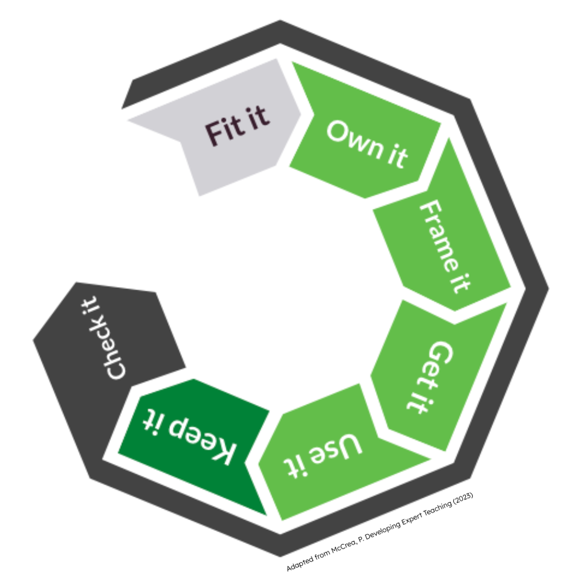
Purpose
What is a check for understanding?
Notes:
‌

Slide 7

Purpose
Why are checks for understanding important?
checks specific knowledge is secure
explicitly checks for mistakes and misconceptions
diagnose and adapt
Third-party content images: © https://www.flaticon.com/free-icons/diagnostic" title="diagnostic icons">Diagnostic icons created by ghost_icon - Flaticon</a>

Slide 8
Purpose
Why is checking for understanding considered an essential component of a lesson?
It allows pupils to skip content they already know.
It helps teachers adapt their teaching in real-time based on pupil responses.
It ensures pupils always pass their exams.
It guarantees all pupils master learning content on the first attempt.

Slide 9



Purpose
Design considerations
snappy
carefully selected
peppered
Third-party content images: © <https://www.flaticon.com/free-icons/time" title="time icons">Time icons created by Freepik - Flaticon ; https://www.flaticon.com/free-icons/alert" title="alert icons">Alert icons created by Freepik - Flaticon ; https://www.flaticon.com/free-icons/pepper" title="pepper icons">Pepper icons created by Freepik - Flaticon

Slide 10
Purpose
CfUs should be peppered throughout the explanation.
Why?
Repeatedly checking for understanding reinforces key learning points, addresses misconceptions and supports the process of moving learning to our long-term memory.

Slide 11
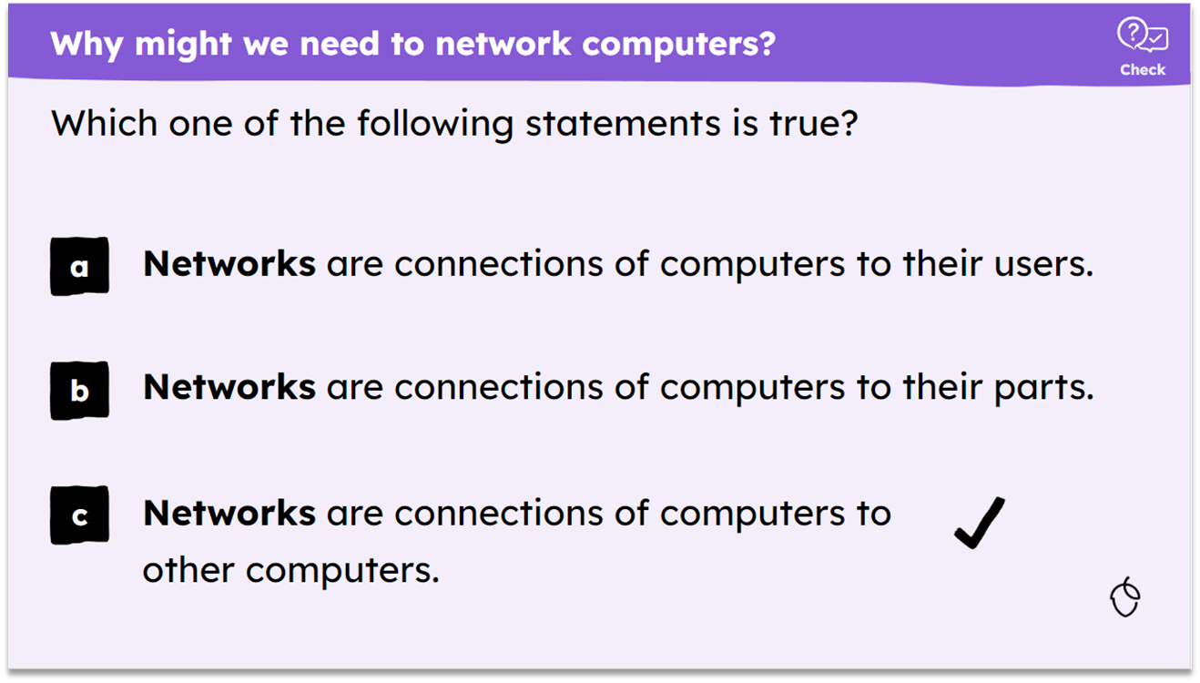
Purpose
addresses a key learning point
plausible distractors
pupils need to think hard
KS3 computing

Slide 12
Purpose
Which of the following is a primary reason checks for understanding should include plausible distractors?
To reduce the time spent on assessment.
To make a test harder for pupils.
To expose common misconceptions.

Slide 13
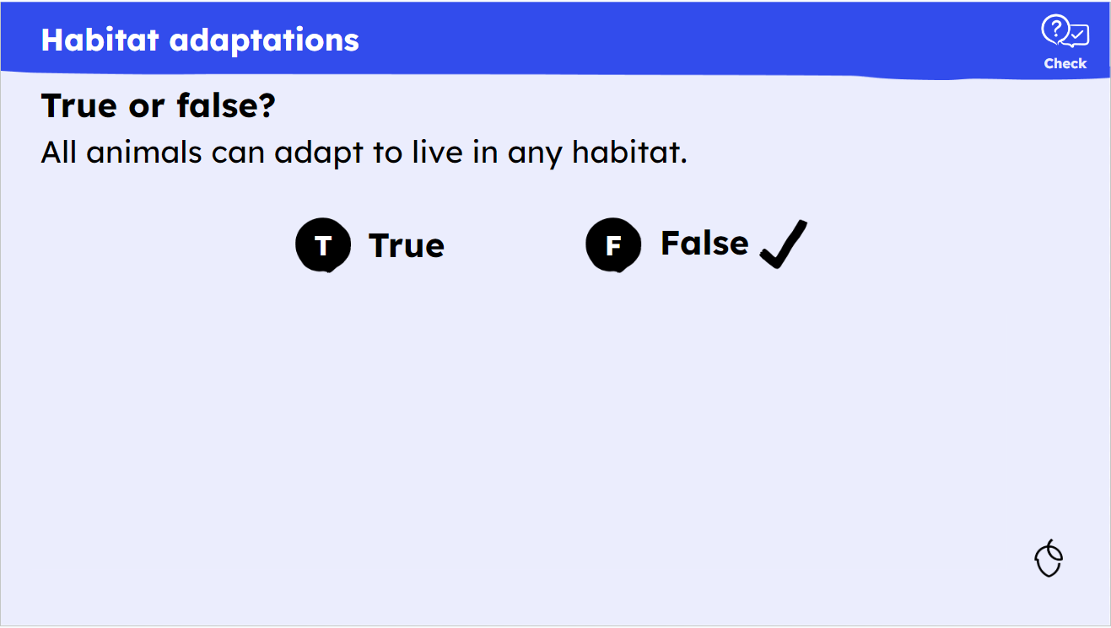
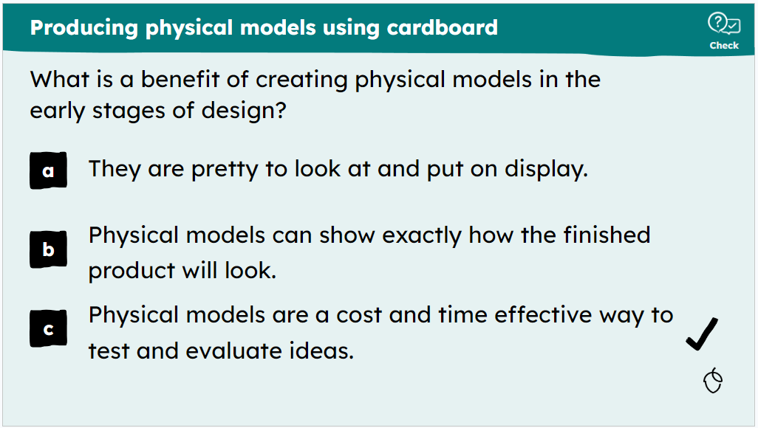
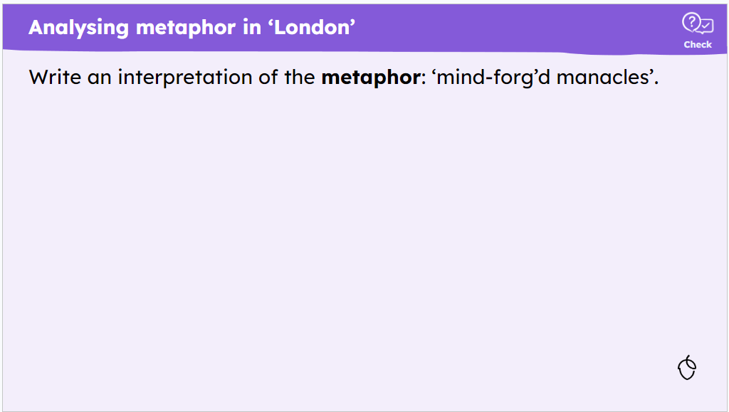
Purpose
Read the explanation and review the check for understanding.
Identify the mistakes in each of the checks for understanding below:
Example 1: KS2, science
Example 2: KS3, design and technology
Example 3: KS4, English
Oak created examples

Slide 14
Purpose
Read the explanation and review the check for understanding.
Identify the mistakes in each of the checks for understanding below:
Example 1: KS2, science
Example 2: KS3, design and technology
Example 3: KS4, English
The answer is false but there is no ‘why’ being asked.
The first distractor is of poor quality making it easier to guess at the correct answer.
This will take too long to answer and more like a practice task.

Slide 15
Quality Checks for Understanding (CfU)
Purpose
Approaches

Slide 16



Approaches
multiple-choice
short answer
true/false/why
Third-party content images: © "https://www.flaticon.com/free-icons/multiple-choice" title="multiple choice icons">Multiple choice icons created by Freepik - Flaticon ; answer by Aufa John from <a href="https://thenounproject.com/browse/icons/term/answer/" target="_blank" title="answer Icons">Noun Project</a> (CC BY 3.0) ; https://www.flaticon.com/free-icons/yes-no" title="yes no icons">Yes no icons created by Freepik - Flaticon</a>

Slide 17
Approaches
Which of the following are not examples of CfU which we use at Oak?
match questions
multiple choice questions
short answer questions
sort questions

Slide 18
Approaches
Short answer questions
limited plausible distractors
multiple-choice alternatives (distractors) might introduce or reinforce a misconception
check spelling
higher degree of challenge
Third-party content images: © answer by Aufa John from <a href="https://thenounproject.com/browse/icons/term/answer/" target="_blank" title="answer Icons">Noun Project</a> (CC BY 3.0)

Slide 19
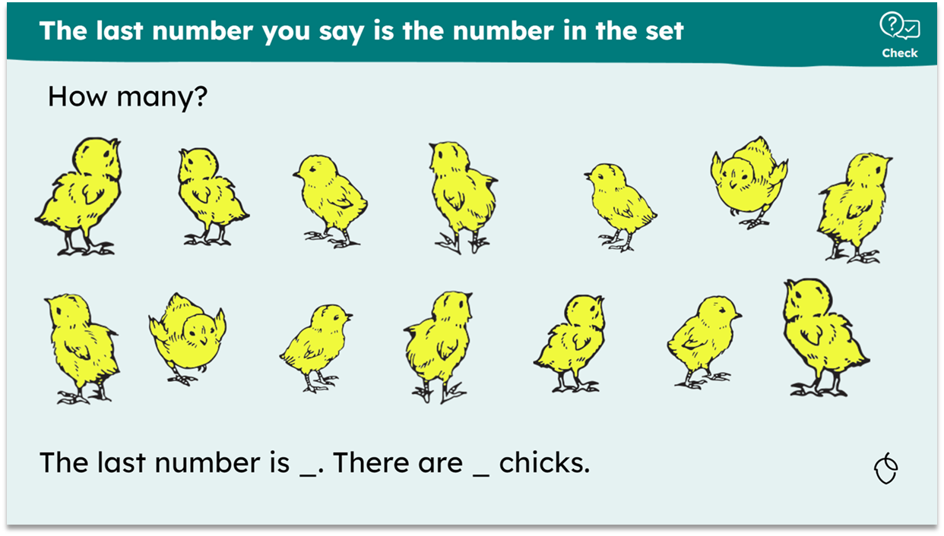
Approaches
Short answer questions
visual
quick count
appropriate to phase
KS1, maths

Slide 20
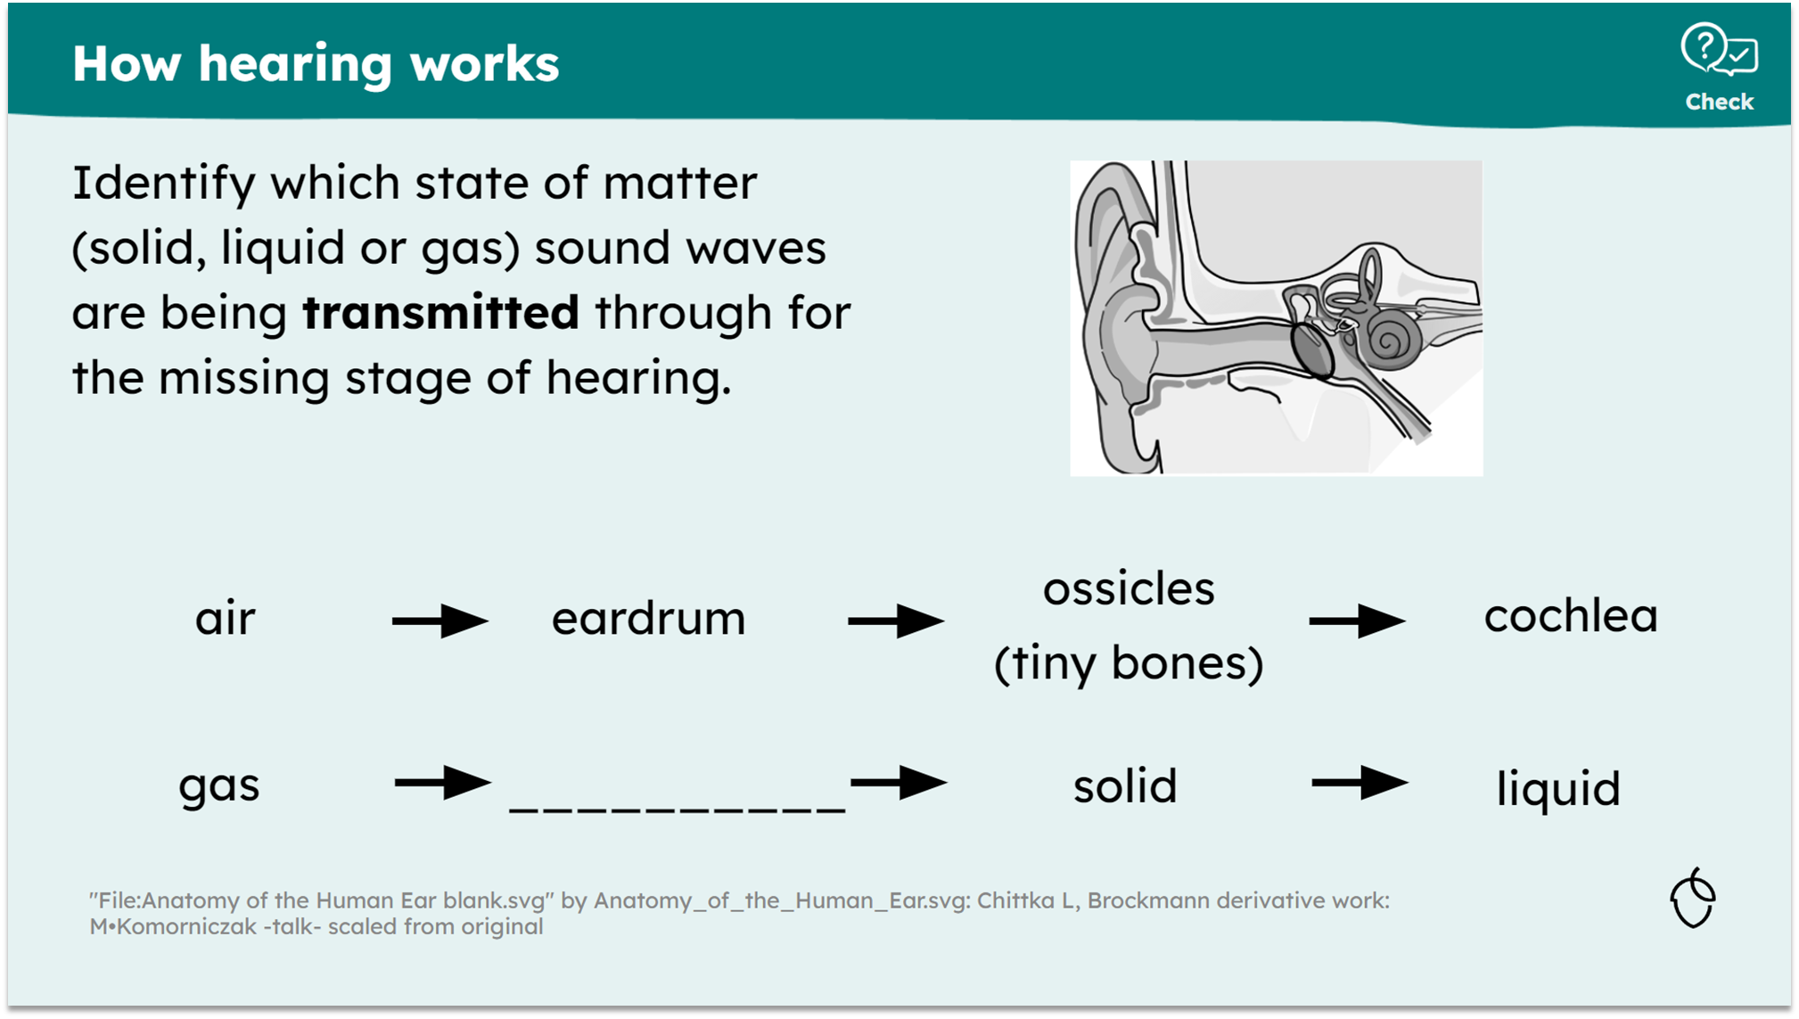
Approaches
Short answer questions
gap fill
quick to respond
KS4, combined science

Slide 21
Approaches
Complete the sentence: One reason for using a short answer CfU is…
You might have said:
when there are limited plausible distractors
to check spelling
where multiple-choice alternatives (distractors) might introduce or reinforce a misconception
a higher degree of challenge is desired

Slide 22

Approaches
True/false/why
simple fact to check
50/50
justification of false answer
“checking for meaning”
deep/higher order thinking
Third-party content images: © https://www.flaticon.com/free-icons/decision-making" title="decision making icons">Decision making icons created by Freepik - Flaticon</a>

Slide 23
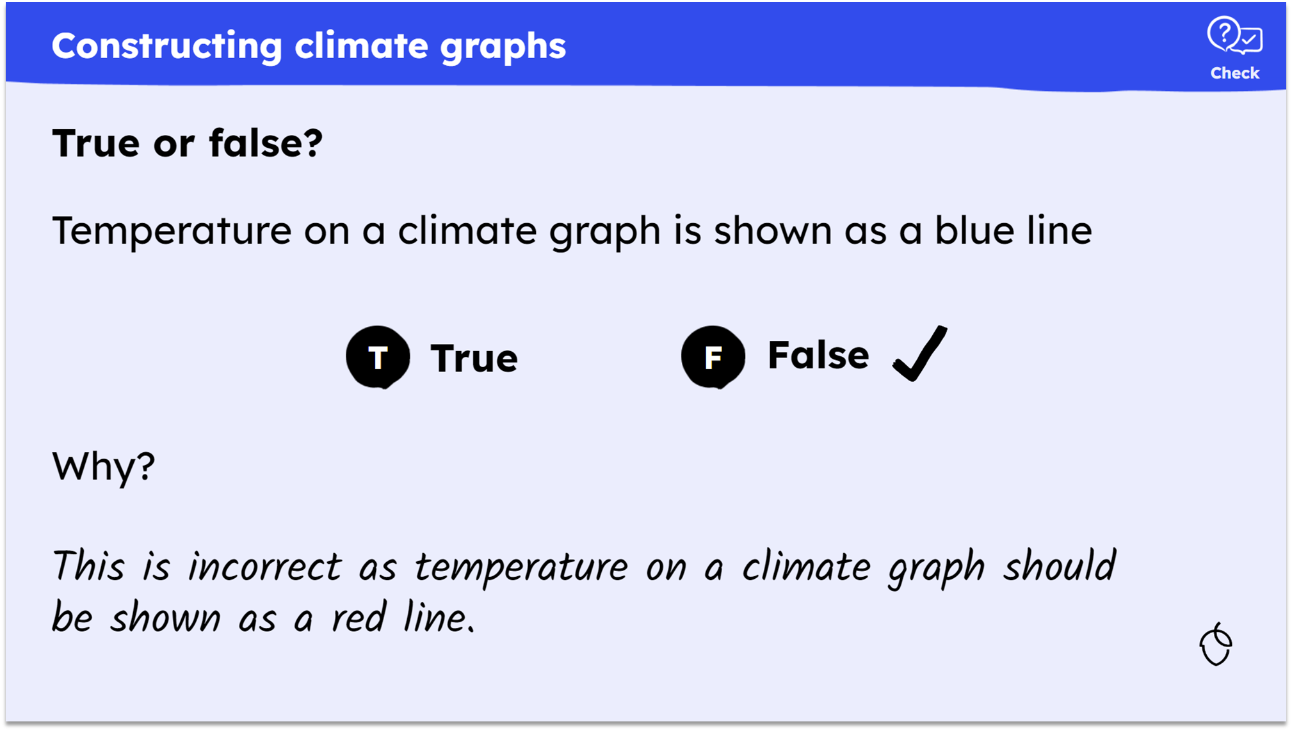
Approaches
True/false/why
justification of false is checked
KS3, geography

Slide 24
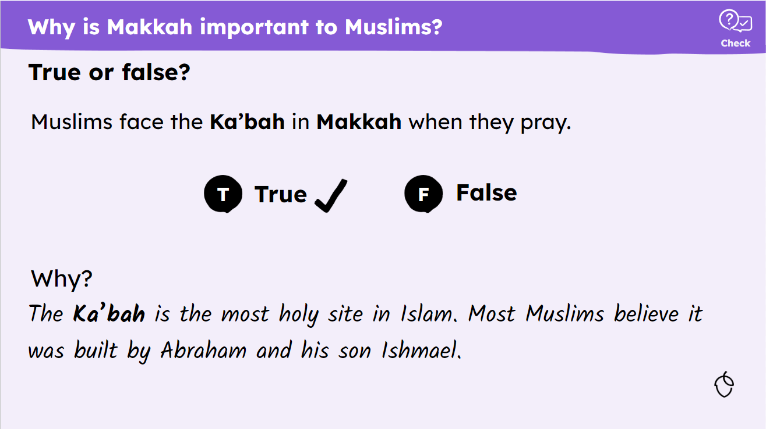
Approaches
True/false/why
deeper thinking
rationale
KS2, religious education

Slide 25
Approaches
Create checks for understanding for this learning cycle.
In pairs, review the lesson title, key learning points, lesson outcome, explanation, practice task and feedback.
Discuss and decide what type of checks for understanding work best.
Discuss and decide where they (minimum two) should be placed.
Write your checks for understanding.

Slide 26
Approaches
Present and compare your checks with the rest of your table.

Slide 27
Quality checks for understanding
snappy
carefully selected
peppered
multiple-choice
short answer
true/false/why
Third-party content images: © https://www.flaticon.com/free-icons/time" title="time icons">Time icons created by Freepik - Flaticon ; https://www.flaticon.com/free-icons/alert" title="alert icons">Alert icons created by Freepik - Flaticon ; https://www.flaticon.com/free-icons/pepper" title="pepper icons">Pepper icons created by Freepik - Flaticon ; https://www.flaticon.com/free-icons/multiple-choice" title="multiple choice icons">Multiple choice icons created by Freepik - Flaticon ; answer by Aufa John from <a href="https://thenounproject.com/browse/icons/term/answer/" target="_blank" title="answer Icons">Noun Project</a> (CC BY 3.0) ; https://www.flaticon.com/free-icons/yes-no" title="yes no icons">Yes no icons created by Freepik - Flaticon</a>

